Slide 1
08 -1-Disk Management

Slide 2
Content
1 - Verify disk usage
2 - Maximize disk capacity
3 - Disk add-on
4 - Limit disk usage
5 - Check file system

Slide 3
1 - Verify disk usage
Verify usage by partition unit
Using df command
Verify usage by directory and file unit
Using du command
Using ls command

Slide 4
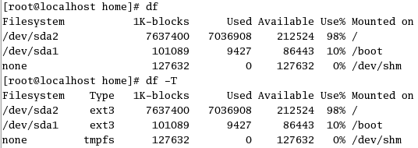
Verify usage by partition unit
df command
#df
#df -T: display with type of file system
Notes:
Free space of each partition can be examined by the df command
The execution of the 'df' command without the option displays the number of all physical blocks for which each file
system can be used, the number of used blocks, the number of empty blocks, and the activity ratio. The format of
the df command is as follows.
df [option]
Major option:
-a : Display also the file system whose number of physical blocks is 0 blocks (pseudo file system such as
‘/proc’, etc).
-h : Display by kilobyte and MB where appropriate.
-i : Display about the ‘i’ node
-k : Display with kilobyte unit.
-m : Display with MB unit.
-P : Display with the POSIX-conforming output format.
-t : Display about the partition of the file system type following ‘-t’
-T : Display also the file system type of each partition.
-x : Display the partition that is not the file system type following ‘-x’.

Slide 5
Verify by directory and file unit
#cd /var/log
#du
list directories and sub directories
#du -a
list all including files
#ls -lR
Notes:
The du command displays the size of the file for each subdirectory after searching for all subdirectories of the specified directory. The format of the ‘du’ command is as follows.
du [option]
Options:
-a :Display the list including not only the directory but also file.
-c : Display the total.
Because the ls command has a lot of options, you can obtain necessary information on the file if you specify by
combining them. The format of the ‘ls’ command is as follows.
ls [option]
Option:
-i : Display the i-node number of the file.
-l : Display detailed information on the file that contain the access permission mode, the owner's user
name the size in byte unit etc
-s : Display the number of logical blocks of files.
-R : Display all files that exist under the control of the directory.

Slide 6
2 - Maximize disk capacity
Delete files which have not been accessed for long time
Delete redudant files
Delete files of user who is no longer using the system
Delete files of user who doesn’t exist on the system

Slide 7
Delete files which have not been accessed for long time
# find /home -type f - atime +60 -print > /var/tmp/deadfile &
[1] 2727
#
[1]+ Done / find /home -type f - atime +60 -print > /var/tmp/deadfile
#more /var/tmp/deadfile
/home/user00/.kde/Autostart/Autorun.desktop
/home/user00/.kde/Autostart/.directory
#rm `cat /var/tmp/deadfile`
Delete ‘core’ file
# find . -name core -exec rm -f {};
Notes:
(1): Search our for files that have not been accessed for more than 60 days and store the list of these files in a temp file
(2): Check content of a temp file
(3): Delete all files. If there are files you wishes not to delete, you should remove these files from the list by editing the temp file.
The core file will be created when the process terminates abnormally. This file is a dump of the memory data that the process was using. It is usually big gile between hundred kilobytes and several megabytes. In Red Hat the default core file name is in a form of core.PID

Slide 8
Delete files of user who is no longer using the system
# find /home -user user00 -print> /var/tmp/myuserfile &
[1] 3599
#
[1]+ Done / find /home -user user00 > /var/tmp/myuserfile
#more /var/tmp/myuserfile
/home/user00/.kde/Autostart/Autorun.desktop
/home/user00/.kde/Autostart/.directory
#rm `cat /var/tmp/myuserfile`
Delete files of user who doesn’t exist on the system
# find /home -nouser -print > /var/tmp/nouserfile &
[1] 3599
#
[1]+ Done / find /home -nouser user00 > /var/tmp/nouserfile
#more /var/tmp/nouserfile
/home/test
#rm `cat /var/tmp/nouserfile`
Notes:
Delete files of user who does not use the system anymore
Delete files of user who have been removed of the systems (has been deleted from the /etc/passwd file)

Slide 9
3 - Add new disk
B1 Check connection of a new disk
B2 Create partition using fdisk
B3 Create file system using mkfs
B4 Mount the file system using mount
Notes:
Shutdown the system before adding new hard disk. Use the following procedure:
(1) Connect the new disk, and turn on the power supply.
Prevent overlapping SCSI-ID with other SCSI equipment when adding the new SCSI disk. A total of Seven
SCSI equipment can be connected to one SCSI controller by using SCSI-ID from 0 to 6. (up to 15 for Wide
SCSI) You can verify the SCSI-ID allocated to each SCSI device using the BIOS utility of SCSI card, or you
can also verify it by executing ‘dmesg’ command or ‘cat/proc/scsi/sci’ in Linux. When the new disk added is
IDE, you can usually connect two disks (master and slave) with each IDE interface. You can verify the device
file name allotted to each IDE disk by the ‘dmesg’ command after the system start-up.
(2) Organize the partition to the increased disk by using the ‘fdisk’ command.
(3) Make the file system by using the ‘mkfs’ command.
(4) Mount the created file system to an arbitrary directory (mount point) by the ‘mount’ command. This enables
the access to the increased file system. To set the automatic mount at the system start-up, it is necessary to edit
the ‘/etc/fstab’ file.

Slide 10
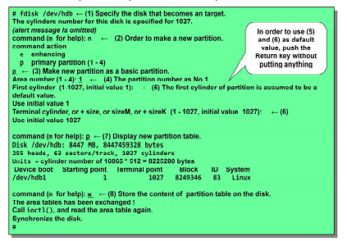
B2 Create partition using fdisk
Notes:
The fdisk command maintains the disk partition by the menu form. The ‘fdisk’ command allows you to display information on the disk partition, to create and to delete the disk partition. The format of the ‘fdisk’ command is as
follows.
Option:
fdisk [option] [device]
-l : Display the partition tables, and then exit
The specified devices are generally ‘dev/hda’, ‘/dev/hdb’, ‘/dev/sda’ and ‘dev/sdb’.
Main interactive commands:
d : Delete the current partition
l : Display all types of the partition
m : Display the help menu (command group)
n : Create a new partition
p : Display the list of all partitions and information on each partition
q : Quit without saving changes
w : Save the change and exit

Slide 11
Notes:
Below is an example of creating the partition using empty capacity of the system disk.
# fdisk /dev/hda ... Specify a device file name of the system device
The number of cylinders for this disk is specified for 1222.
Though there is no problem, but because it exceeds 1024,
be sure that a problem may be caused in the following cases :
1) Software executed when booting it (Example: old version LILO)
2) Boot of other OS and partition making software
(Example: DOS FDISK OS/2 FDISK)
Note: Warning will be displayed, but you may disregard it.
command (m for help): n …… Make a new partition
starting cylinder (679-1222, initial value) : 679 ………… Set initial value for default value
terminal cylinder, +size, + sizeM, or +sizeK (679-1222, initial value 1
222): 1222
command (m for help): p ….. Display a new partition table
Disk /dev/hda: 10 0 GB 10056130560 bytes
255 heads, 63 sectors/track, 1222 cylinders
Units = cylinder number of 16065 * 512 = 8225280 bytes
Device Boot Starting point Terminal point Block ID System
/dev/hda1 * 1 13 104391 83 Linux
/dev/hda2 14 78 522112+ 82 Linux Swap
/dev/hda3 79 600 4192965 83 Linux
/dev/hda4 601 1222 4996215 5 Extended partition
/dev/hda5 601 665 522081 83 Linux
/dev/hda6 666 678 104391 83 Linux
/dev/hda7 679 1222 4369648+ 83 Linux
command (m for help): w ……….. Write the disk the content of the partition table newly made
The area tables were exchanged !
Call icotl(), and read the area table again.
Warning: It failed because of the area table rereading by error 16: device or resource
is a busy status.
The kernel still uses an old table.
New table will be able to be used t next reboot.
Synchronize the disk.
#
# reboot
･･･ Do the reboot of the system because warning that urged the reboot appeared
when w subcommand of fdisk is executed.
Broadcast message from root (pts/1) (Mon Aug 30 16:04:56 2004):
The system is going down for reboot NOW!
# fdisk –l
... Execute the fdisk-l command after the reboot, and verify whether
the partition was correctly made

Slide 12
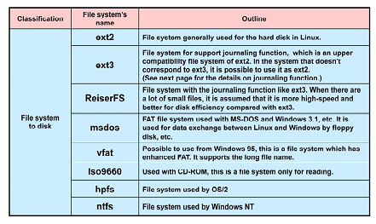
File system type
Notes:
Linux supports a lot of file systems compared with commercial UNIX. The mechanism named VFS (Virtual File System) enables these file systems to be accessed at the user level with a uniformed interface.
The type of each file system can be divided roughly into the disk-based file system, the network-based file system,
and the pseudo file system. The main disk-based systems are ext2, ext3, ReiserFS, msdos, vfat, iso9660, hpfs,and
ntfs, and more.

Slide 13
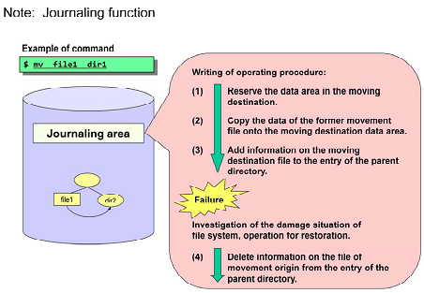
Notes:
The journaling function is a function to record the modified contents to the file system in order to restore it at once if a trouble occurs within the file system.
Concrete contents of the journaling function are as follows.
The journaling function doesn't write data at once to the disk, it first writes the procedure that will be operated in
the place called the journaling area. Then, it writes the actual data onto the disk, and delete then deletes the
operation procedure from the journaling area upon completion of writing operation procedure from the journaling area upon completion of writing.
When the file system is damaged by a sudden occurrence such as system crash or power supply failure, it examines
the damage to the file system and based on the information written in the journaling area, it will perform recovery
of required.
Thus, it is not necessary for you to repair the damage over the entire file system using the ‘fsck’ command, so that
you can shorten a lot the time required to restore the file system.
In addition, the journaling function improves the recoverability of the file system.
File systems that support the journaling function that are applicable on Linux include ‘JFS’ of IBM, ‘XFS’ of SGI, besides ‘ext3’ and ‘ReiserFS’.

Slide 14
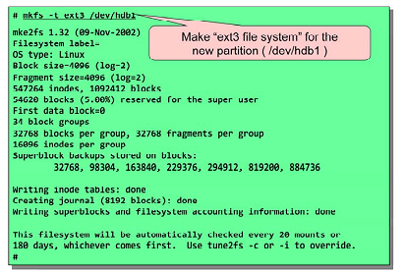
B3 Create file system using mkfs
Notes:
The mkfs command is used to build afilesystem on a device (usually aharddisk partition). The format of the y (y p)
‘mkfs’ command is as follows.
Option:
mkfs [option] [Exclusive option for file system] Device name [ blocks ]
-t< file type > : Type of file system to construct. The default is ext2 file system.
File type used usually:
ext2 : Standard file system of Linux
ext3 : Standard file system of Red Hat Enterprise Linux It is added the journal function to ‘ext2’
Dedicated option to the file system:
Specify after the general option that was mentioned above.
-c : Check whether there is defective block in the device before the implementation of the file system.
The device name is the device name making the file system (/dev/hdal, /dev/shb2, etc.), or the mount point (/, /usr,
/home, etc.). ‘blocks’ is the number of blocks of the file system to be created.

Slide 15
B4 Mount the file system
Mount the file system using command
#mkdir /work (1)
#mount /dev/hdb1 /work (2)
#umount /work (3)
Notes:
All files accessible in a Linux system are arranged in one big tree structure. In other words, it is a hierarchy
structure which has the root as ‘/’ (root: value). These file groups can be spread out over several devices. The
mount command is used to attach the file system of a device to the big tree structure. The format of the ‘mount’
command is as follows.
mount [option] [Device] [Mountpoint]
Major options:
-t <type> : Specify the file system type. Examples: ext2, ext3, auto, vfat, iso9660, etc.
-r : Mount the file system as read-only.
-w : Mount the file system as read/write. (This is default)
-v : Display a detailed message.
-a : Mount everything that 'noauto' is not specified among the file systems in ‘/etc/fstab’.
-o<attribute>: Mount by specifying the attribute specified in ‘/etc/fstab’. To specify several attributes, arrange them by delimiting by the comma.
When the ‘mount’ command is executed without specifying the argument, the list of presently mounted file system
is displayed.
To mount a new file system, prepare the mount point at first ((1) of the above figure). Next, mount the file system
((2) of the above figure). To backup the file system, unmount the file system. ((3) of the above figure).

Slide 16
Notes:
The option following ‘-o’ is different according to the file system type to be mounted. The options that are used usually in the 'ext3' file system are as follows.
rw : Mount the file system read/write mode.
ro : Mount read-only.
remount : Re-mount by the option to be specified newly.
check : Set checking level when mounting the file system.
When it is ‘check=normal’, ‘i’ nodes and block bitmaps are checked when it is mounted.
When it is ‘check=strict’, check also the unallocation block and the data.
When it is ‘check=none’, no checking is done. The default value is ‘check=normal’.
errors : Specify the operation when the error occurs. The default value is ‘errors=continue’.
When it is ‘errors=continue’, the processing is continued.
When it is ‘errors=remountro’, it is remounted by read only when an error is encountered.
When it is ‘errors=panic’, it becomes a panic, and the system stops it the error occurs.
When the mount is to be released, the umount command is used. The format of the ‘umount’ command is as follows follows.
Exapmle: Mount and unmount of ‘home’ partition.
umount [mount_point]
# mount /dev/hda6 /home
Note: Label name of device file
You can give the label name corresponding to the role as the device file name which shows partition. This enables
the access to the partition by the label name.
Use the e2label command in order to give a label name to the partition The format of the ‘e2label’ command is as
e2label device_file_name label_name
# umount /home
The label name up to 16 characters (mount point name, etc.) can be allocated. When the ‘e2label’ command is
executed without giving a name to the label, the label name of the current partition is displayed.
Example: Name the label ‘/work’ to the ‘hdb1’ partition, and mount it. Verify the label name at the end.
# e2label /dev/hdb1 /work
# mount LABEL=/work /work
# e2label /deb/hdb1

Slide 17
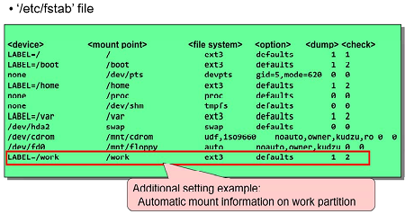
Automatic Mount
Notes:
At the system start-up, the file system is mounted automatically based on the description of /etc/fstab file.Register regular mount information in this file.
Each field of this file is separated by whitespace, and each field has the following meanings.
The format of the ‘/etc/fstab’ file is as follows.
<device> <mountpoint> <file system> <option> <dump> <check>
Meaning of each item:
Device : Device file name at the execution of a ‘mount’ command. In file systems such as ‘ext2’ and
‘ext3’, the label name can be specified by the format “LABEL = label name” instead of the
device file name. “none” indicates the file system that the kernel uses directly, without using
the device file.
Mountpoint : Directory name that becomes mount point Mountpoint : Directory name that becomes mount point.
File system : Type of file system.
Option : Mount option (option of ‘mount’ command). Options of ‘rw’, ‘suid’, ‘dev’, ‘exec’, ‘auto’,
‘nouser’, and ‘sync’ are set by using the ‘defaults’ option.
Dump : If it is 1, the ‘dump’ command assumes it to be a backup object. If it is 0, the ‘dump’
command assumes that it is not a backup object. A usual file system specifies “1”.
Check : It is the order of system checking at system starting by ‘fsck’ command. Do not check the file
system if it is 0. If the value of 1 or more is specified, it becomes the object of the check.
Specify ‘1’ for the ‘/(root)’ file system, and specify ‘2’ for other file systems usually.

Slide 18
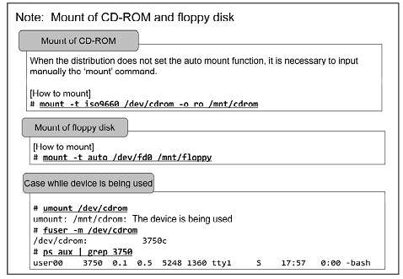
Notes:
Neither CD-ROM nor the floppy disk are automatically recognized by standard Linux. The automatic recognition works in distribution that makes the automount function effective, but in other cases, you have to input the ‘mount’
command manually.
The file system type iso9660 is for CD-ROM. Use it by mounting the ‘/dev/cdrom’deviceto'/mnt/cdrom', etc. In
this case, a warning might be displayed when you did not specify the ‘ro’ option, but there is no special problem in
use.
For the floppy disk, the file system might be different from ‘vfat’and‘ext3’. You may specify each file system, but the ‘auto’ specification will automatically determines file system to be used. Use it by mounting the ‘/dev/fd0’
device to the ‘/mnt/floppy’, etc.
It is necessary to unmount using the ‘umount’ command, before you eject CD-ROM or the floppy disk. For CD-
ROM, the media cannot be taken out of the device, if you did not ‘unmount’. It is possible to take out with the eject
button for the floppy disk, but always remove it only after unmounting. Failure to use the ‘umount’ command
before removing may cause data corruption.
When you try to unmount, the device may “device is busy”. This indicates that the device to be unmounted is being
used by you or by other programs. You can use the ‘fuser’ command to find out what process is using the mounted
device. If you would like to limit the using program, investigate the process ID number of the using process by the
‘fuser’ command, and make the state of the device not used (move and ‘kill’ of the current directory). You can only
unmount the device once it is not used by any process (including yourself and the shells).

Slide 19
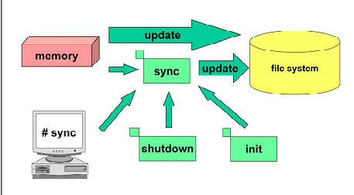
Inspect file system
Notes:
The writing processing to the magnetic disk is temporarily accumulated in the buffer in the kernel, instead of writing it every time when I/O is requested. The data temporarily accumulated in the buffer is written on the hard
disk by the sync command which is regularly issued automatically.
When the system is being shut down or an individual partition is unmounted by the ‘unmount’ command, data that
is in the buffer is written to the disk, and information that the partition was correctly unmounted is written in the
super-block. p
When the power supply of the system cuts before the ‘sync’ command is issued or OS is downed,thereis
possibility that the buffer content is lost or it causes a corruption in the file system's contents.

Slide 20
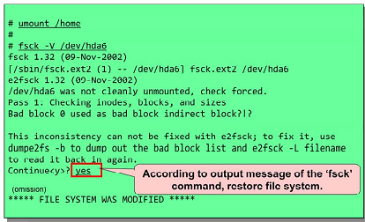
fsck
Notes:
The fsck command is a command that inspects the file system. p y
The file system might be automatically inspected at system startup. This happens when it is not unmounted
normally when shutting down previously or exceeds the mount frequency.
If ‘fsck’ finds a file unmatched, you will be asked whether to execute automatic correction. Most of unmatched are
restored without any problem by the automatic correction.
You can also start the ‘fsck’ command manually. However, if you execute ‘fsck’ with the multiuser mode, it is
better to unmount in advance the file system to be inspected
The format of ‘fsck’ is as follows.
Major options:
fsck [mountpoint or device_name]
-a : Restore the file system automatically without the question.
-r : Do it with interactive mode. The prompt is displayed before it corrects it.
-t<file type>: Specify the file system type.
-A : Check all file systems described in ‘/etc/fstab’.
-N : Restrain usual execution. Only display the contents of executions to be done.
-R : Used with ‘-A’. Check all file systems described in ‘/etc/fstab’ excluding the root file system.
-V: Display the details including commands peculiar to system started with ‘fsck’.

